Slide 1
Cab Service

Slide 2
This project present in git repository in below URL
https://github.com/Kaleakash/cabservice.git
Plz login to virtual lab and clone this project in virtual lab using command as
git clone https://github.com/Kaleakash/cabservice.git

Slide 3
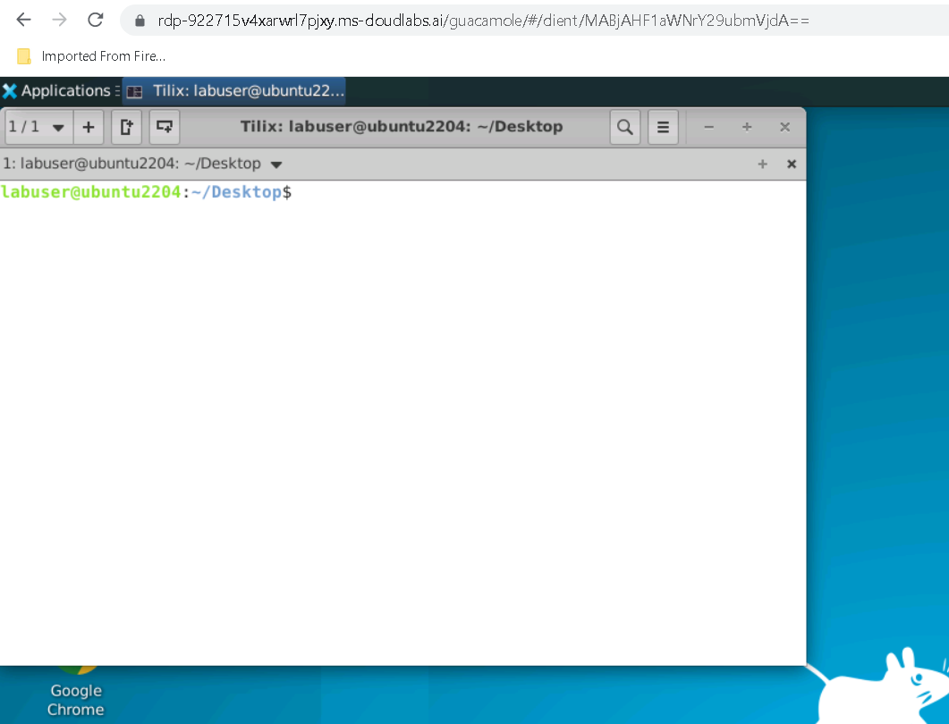

Slide 4
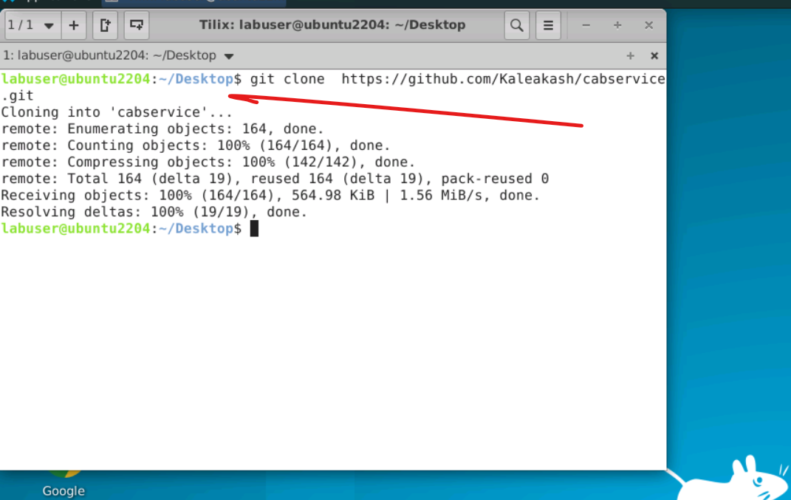

Slide 5
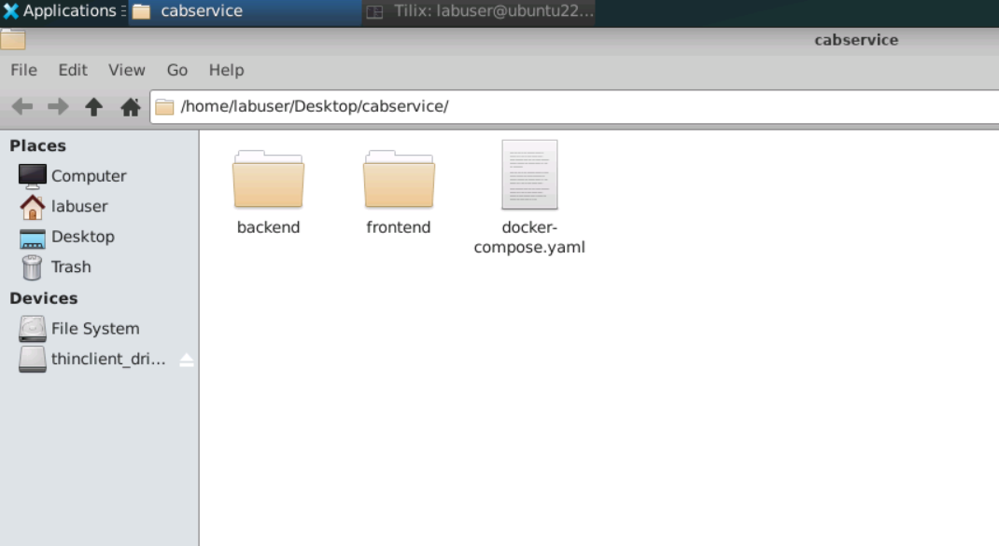

Slide 6
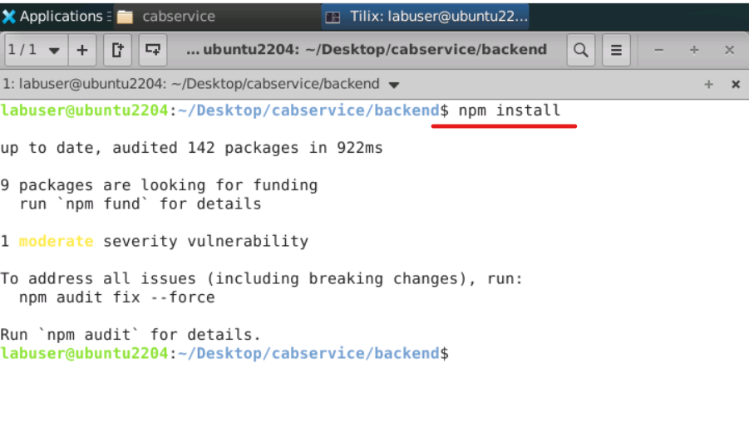

Slide 7
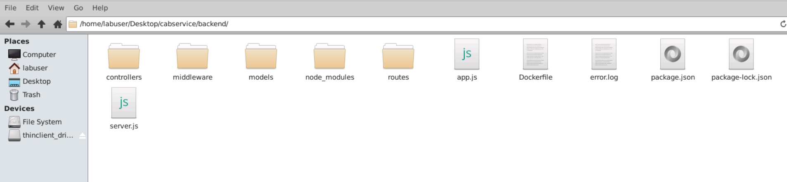
After updated you can see the structure of the project

Slide 8
Project structure explanation
In app.js file we can see the database connection details. If we use local machine database then ip address must be local host or 127.0.0.1 with port number 27017.if we use Docker container then mongo db container name ie present in docker-compose.yml file as database.

Slide 9
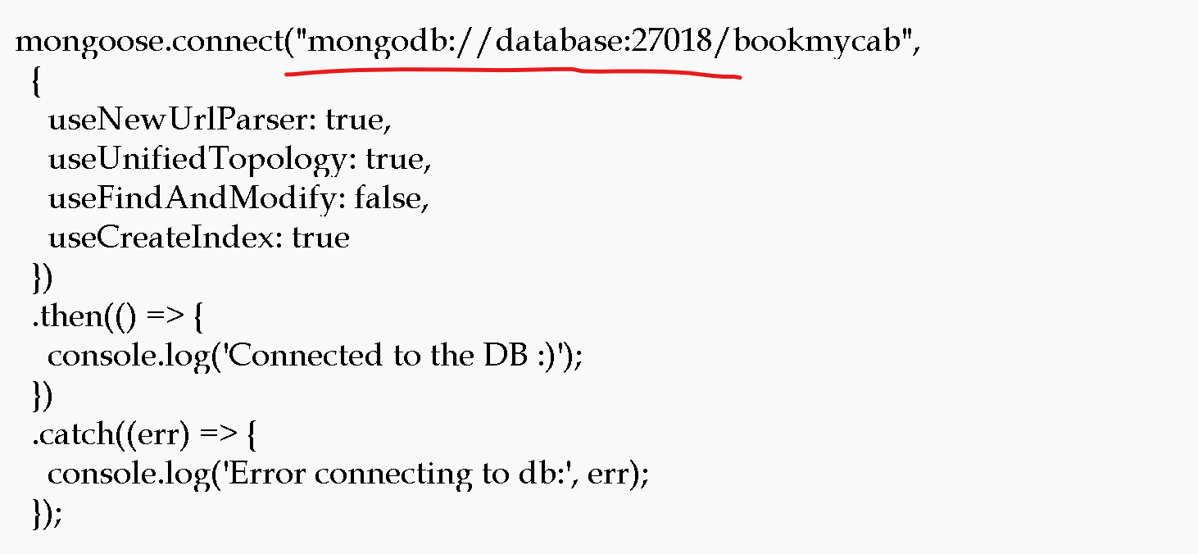

Slide 10
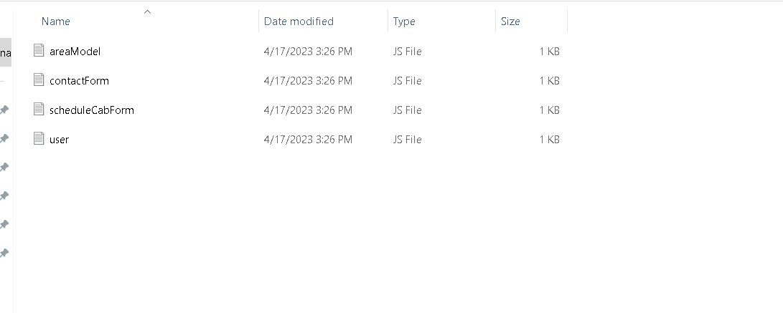
Model file: this file contains the structure of collection with schema definition

Slide 11
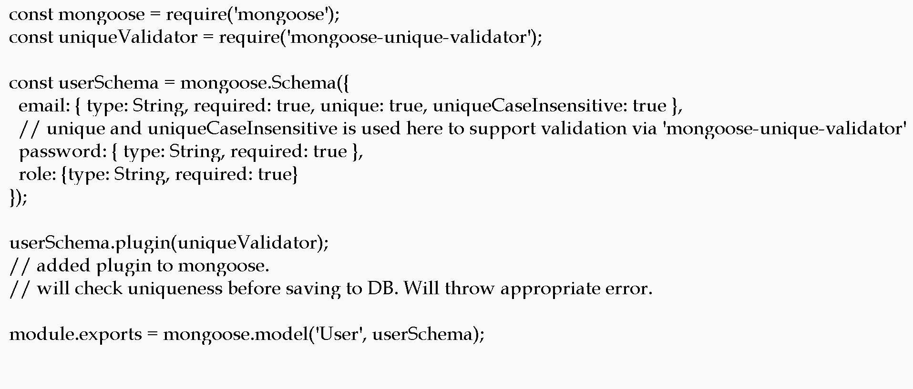

Slide 12
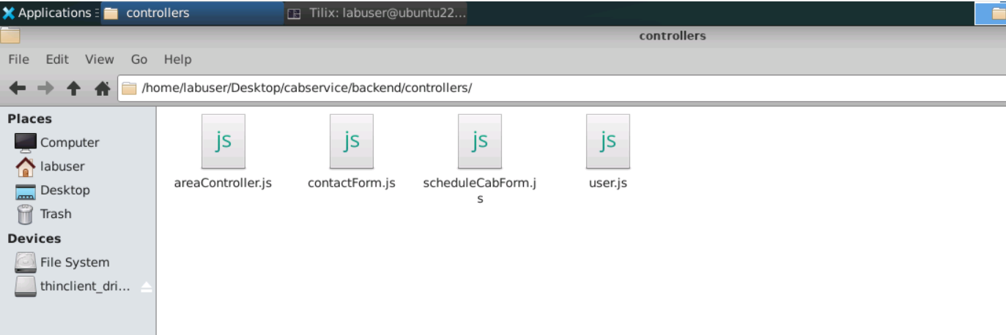
Controller file : which takes req and res and do the operation on model

Slide 13
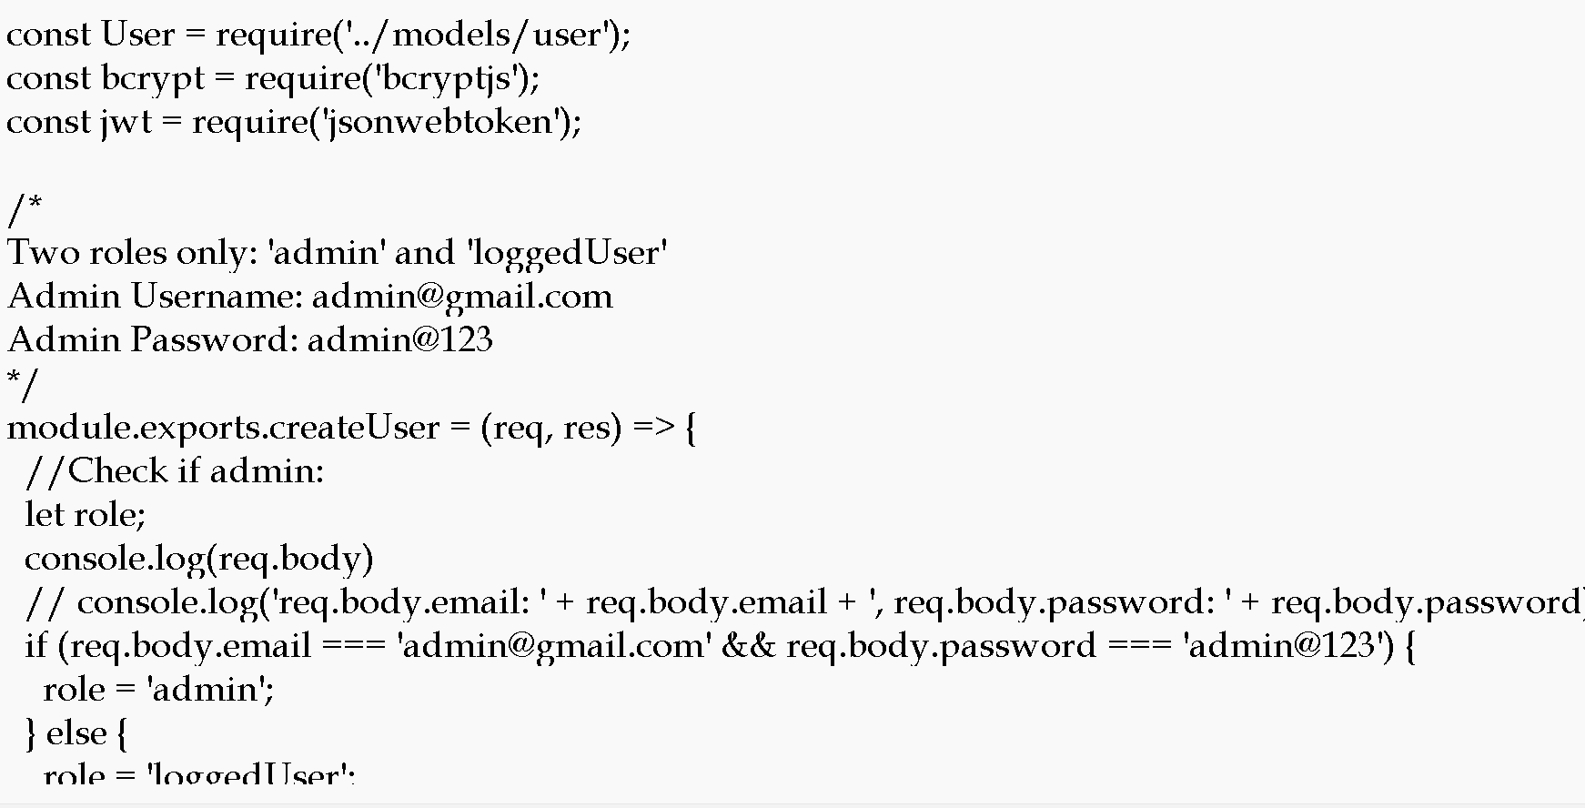

Slide 14
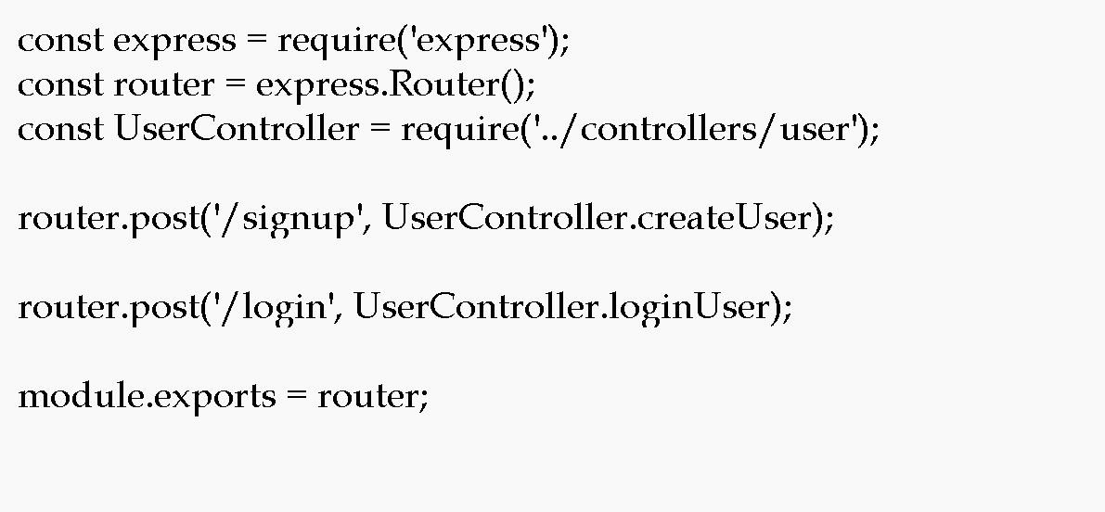
Router : it is use to map the request and http methods.

Slide 15
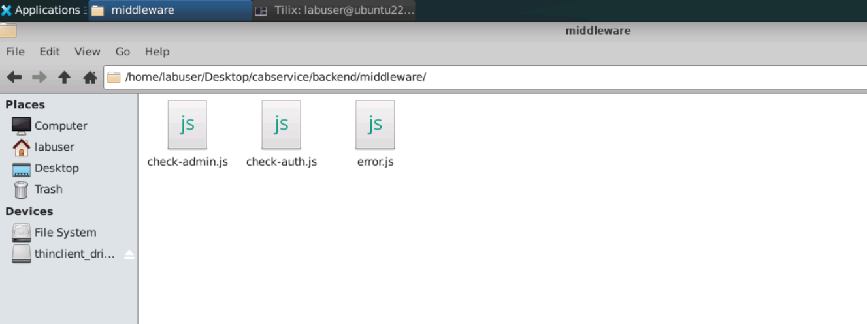
Middleware : this file provide the authentication details for admin and customer

Slide 16
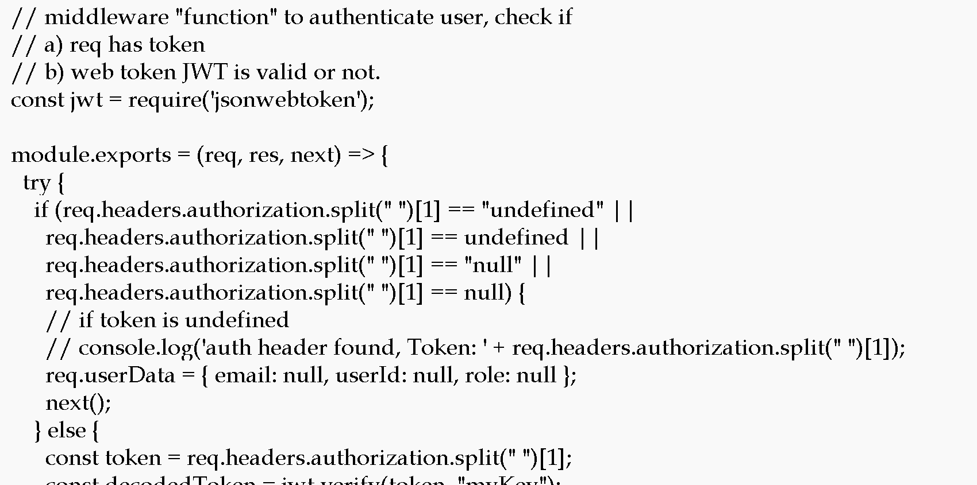

Slide 17
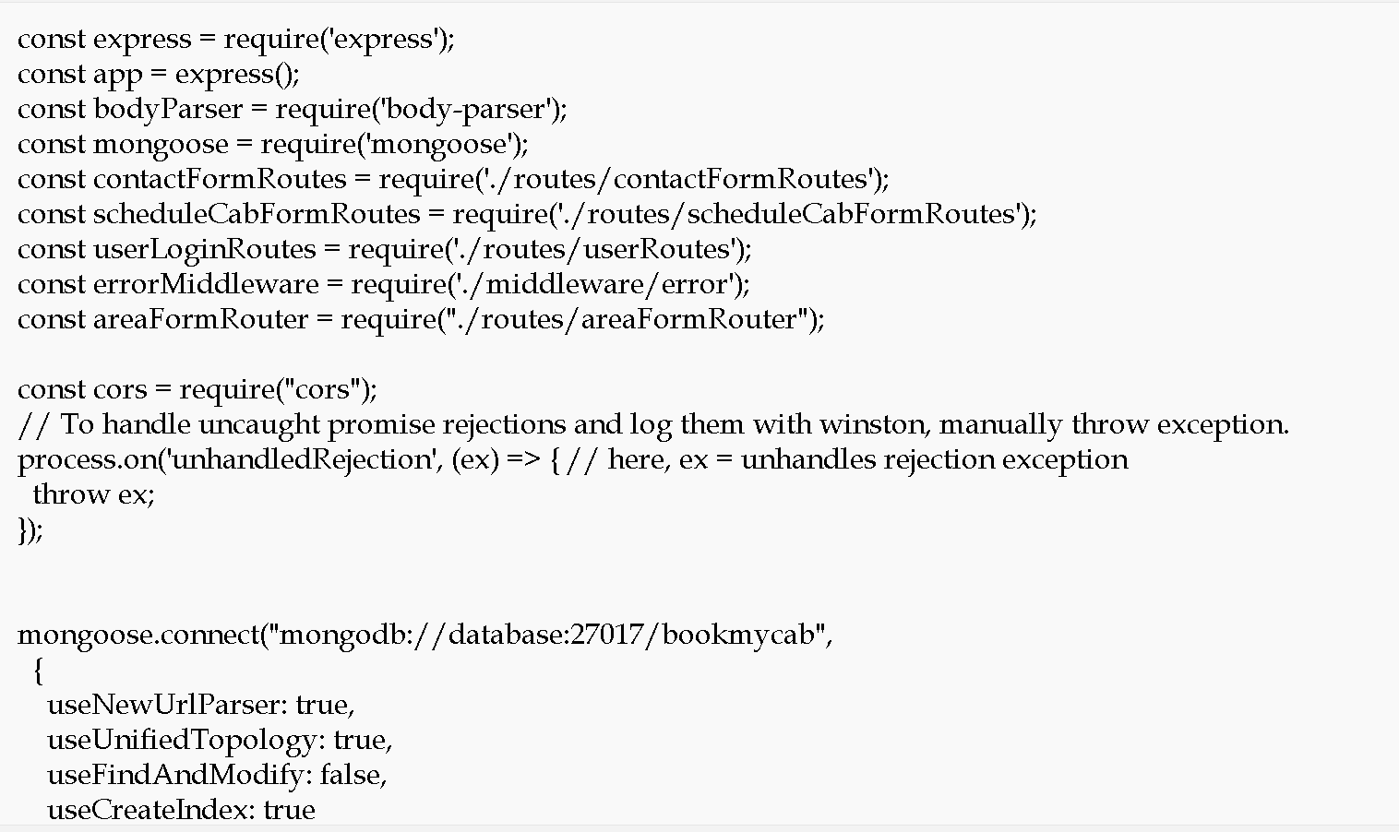
App.js : this is main file. Entry of the application

Slide 18
We will create Dockerfile
We are going to run the project using docker container so we need to create the Dockerfile.

Slide 19
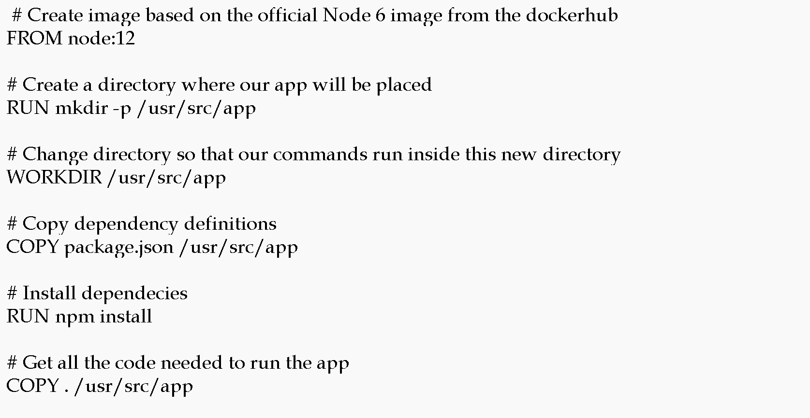

Slide 20
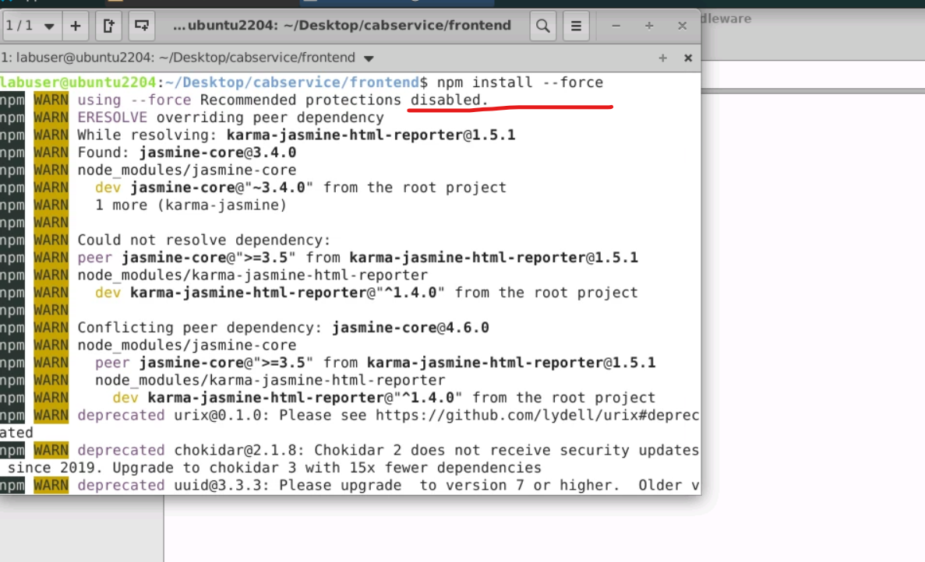
Now move inside a frontend folder
Then run the command as npm install --force to install all required dependencies.

Slide 21
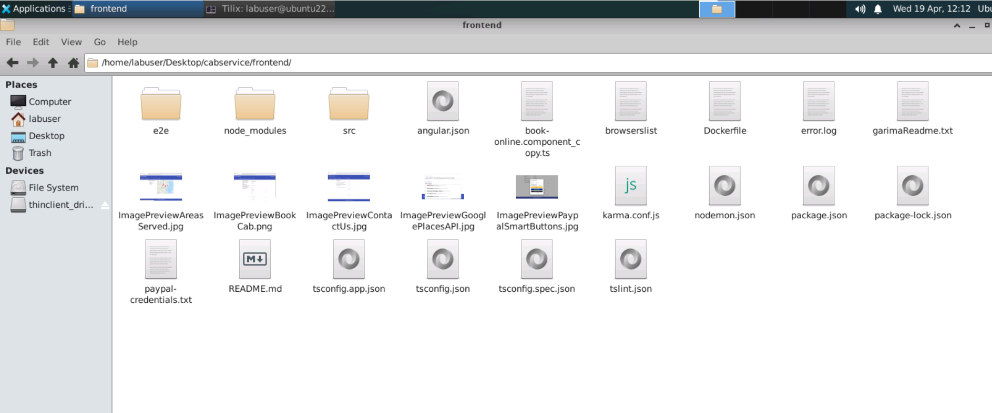
Front – angular project structure

Slide 22
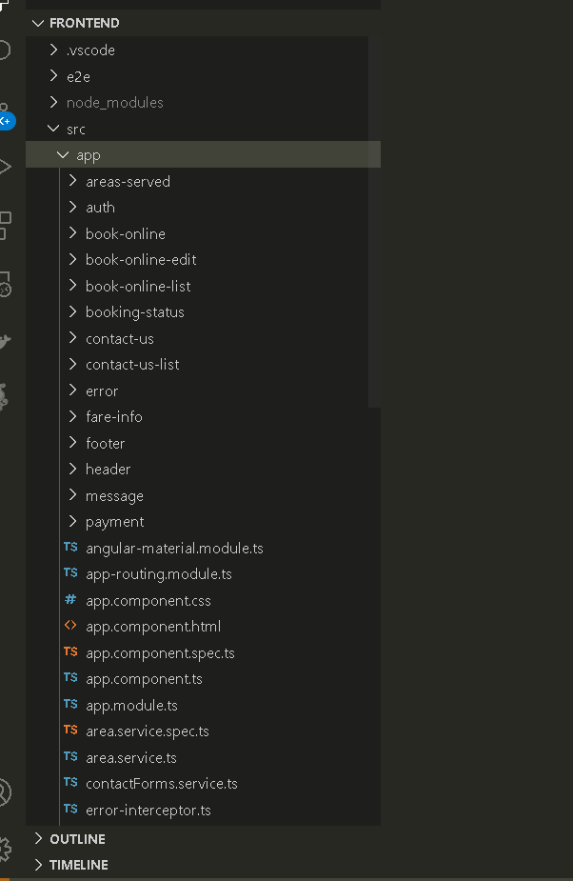
Project structure
Angular project contains lot of components, service as well as model classes .

Slide 23
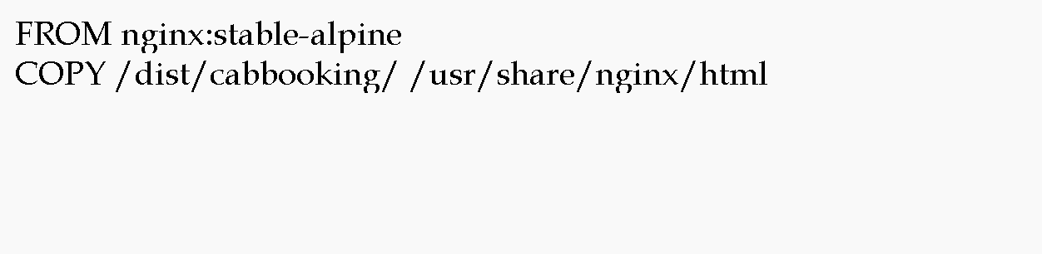
Now we will create the Dockerfile
We are going to run angular project using Dockerfile

Slide 24
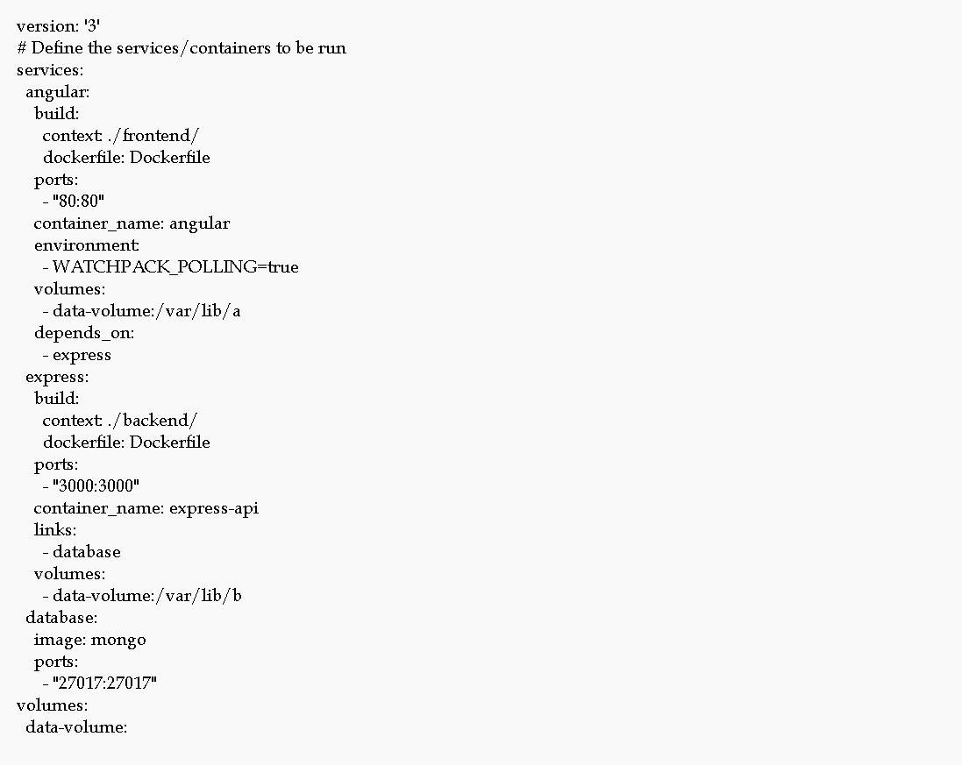
Now will create the docker-compose.yml

Slide 25
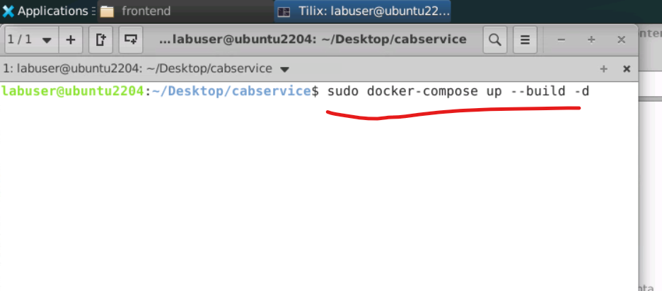
Now run the docker-compose file
sudo docker-compose up --build –d

Slide 26
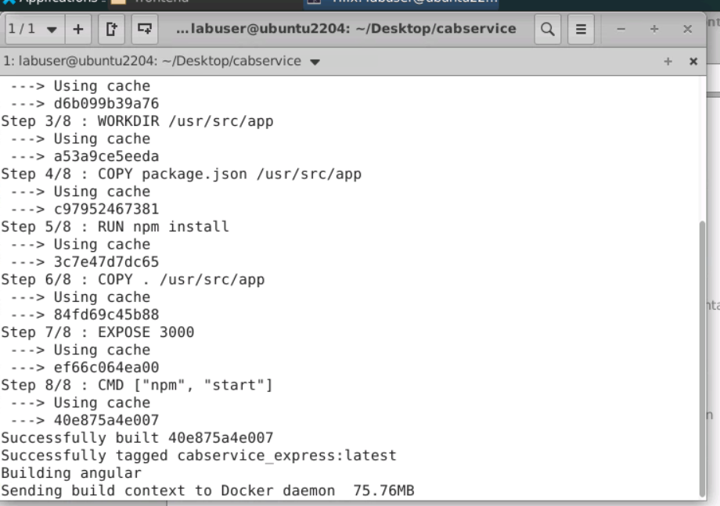

Slide 27
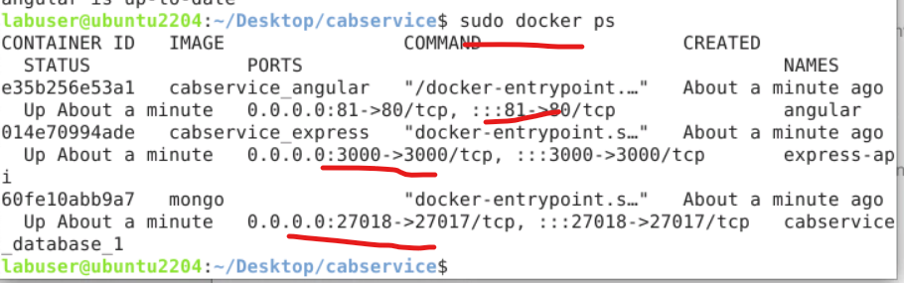
If everything go fine
Then three container get start.
sudo docker ps
angular with nginix server running on port number 81
express js running on 3000
mongo db running on 27018

Slide 28
Now run the application using url as
http://localhost:81

Slide 29
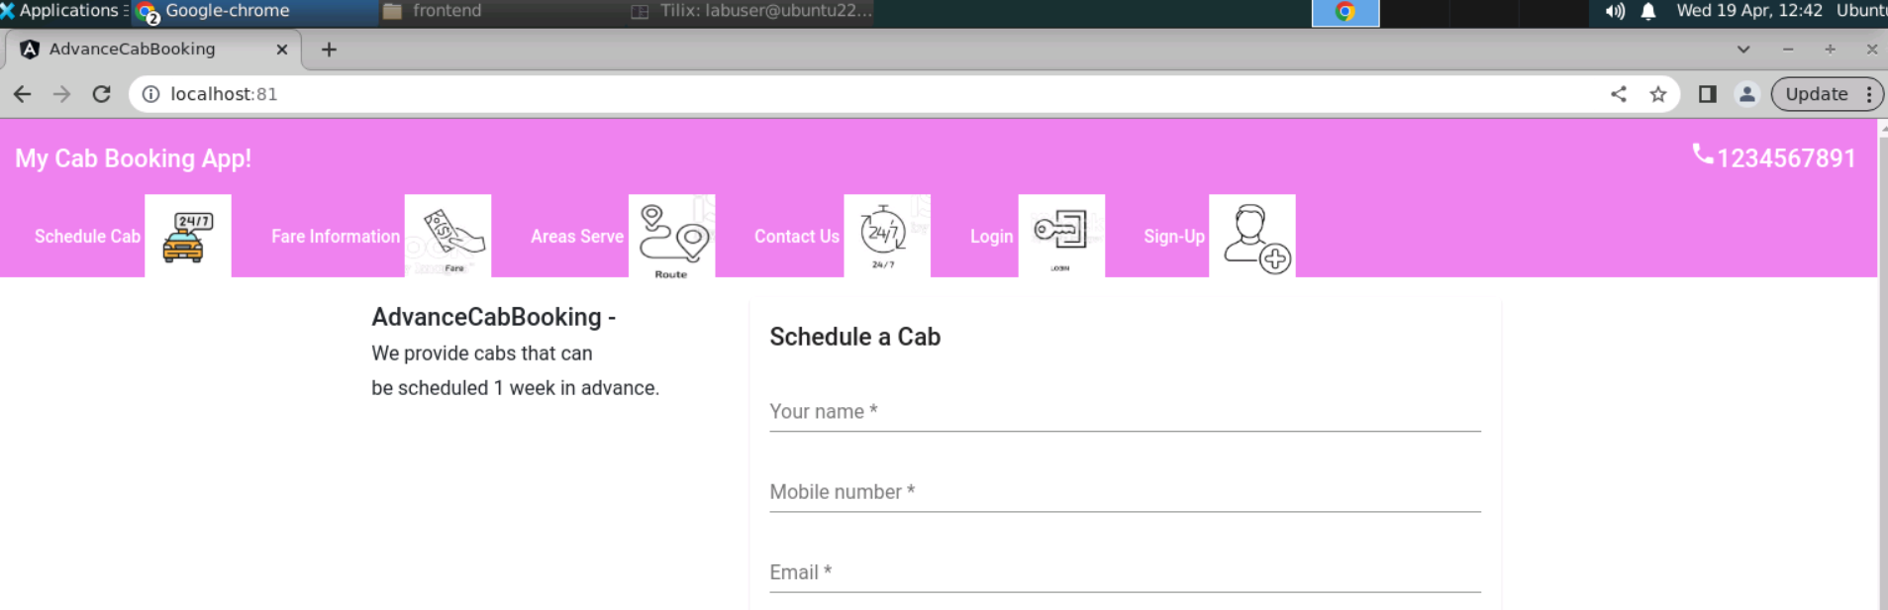

Slide 30
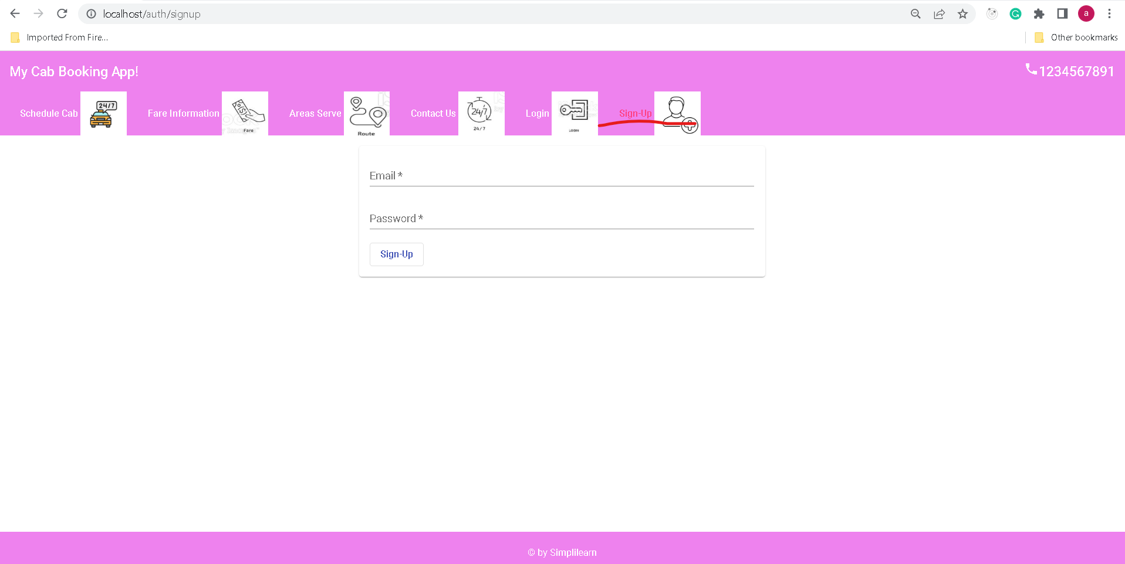
Sign up for the admin user with emailid as admin@gmail.com and admin@123 as password

Slide 31
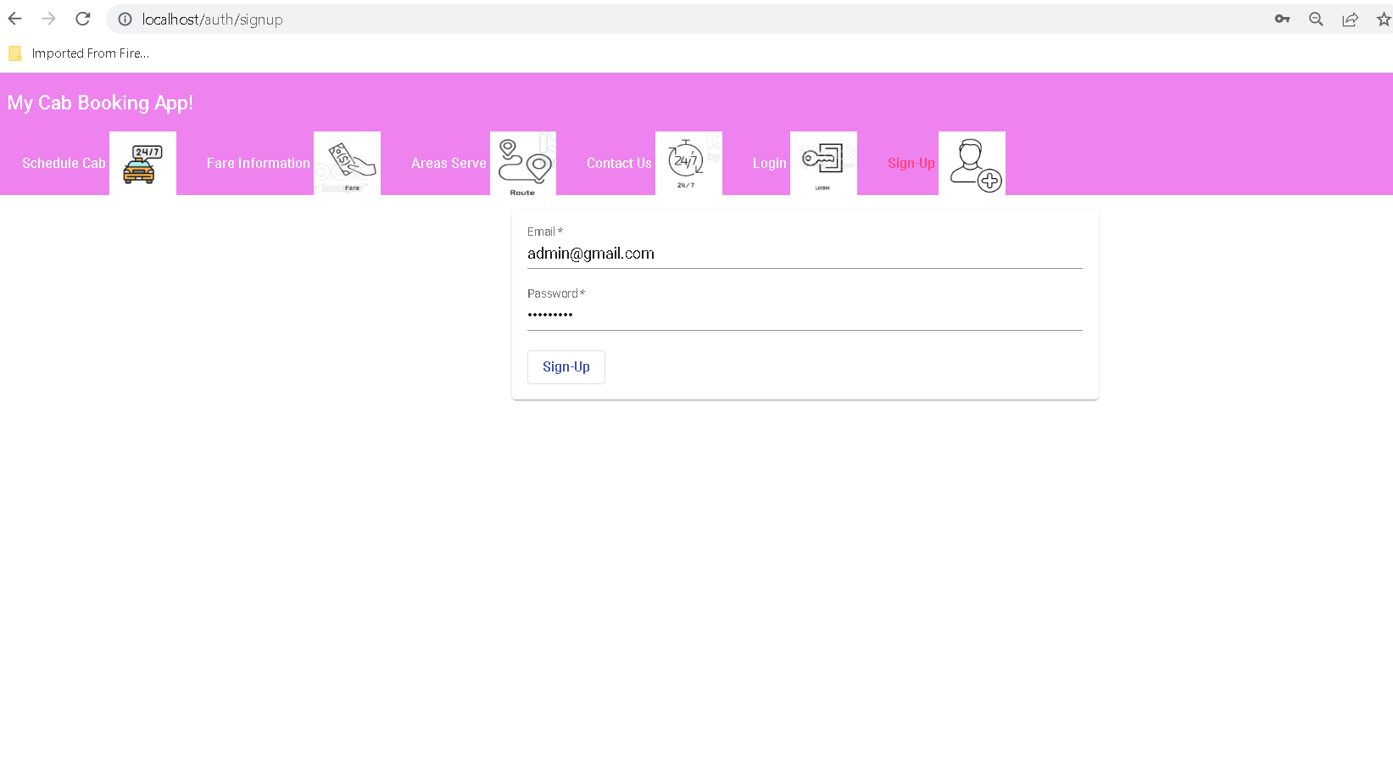
Admin signup

Slide 32
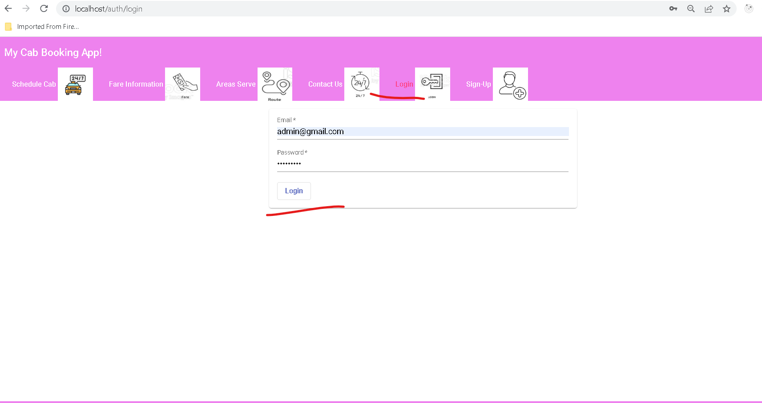
Admin can do the Sign In

Slide 33
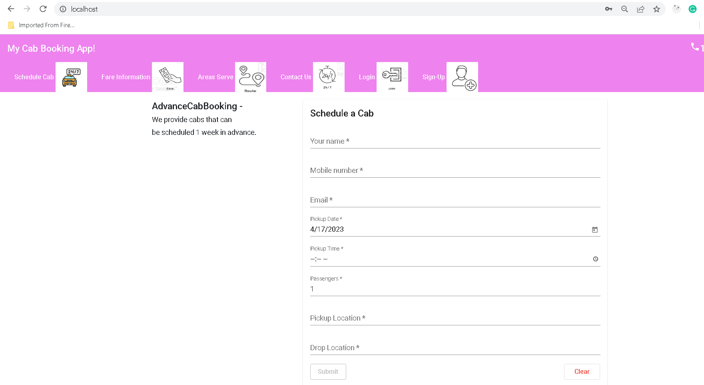
Admin home page

Slide 34
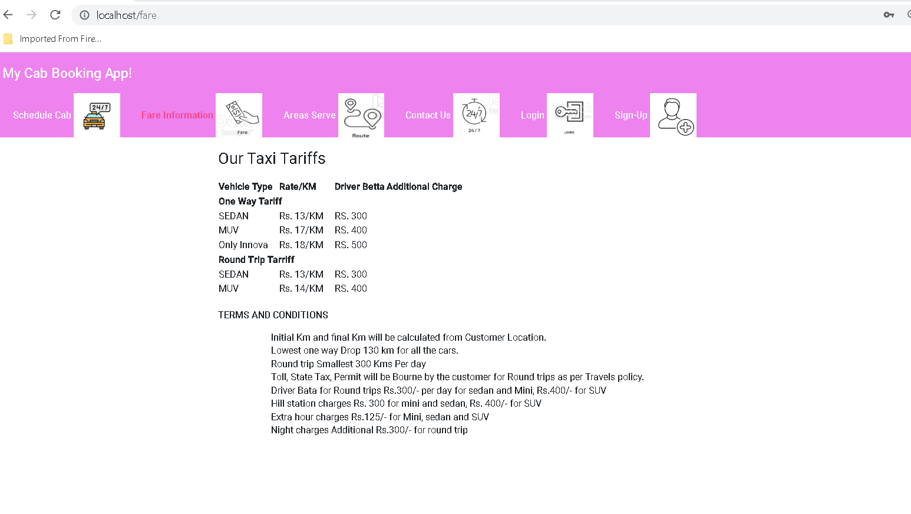
Admin view fare information

Slide 35
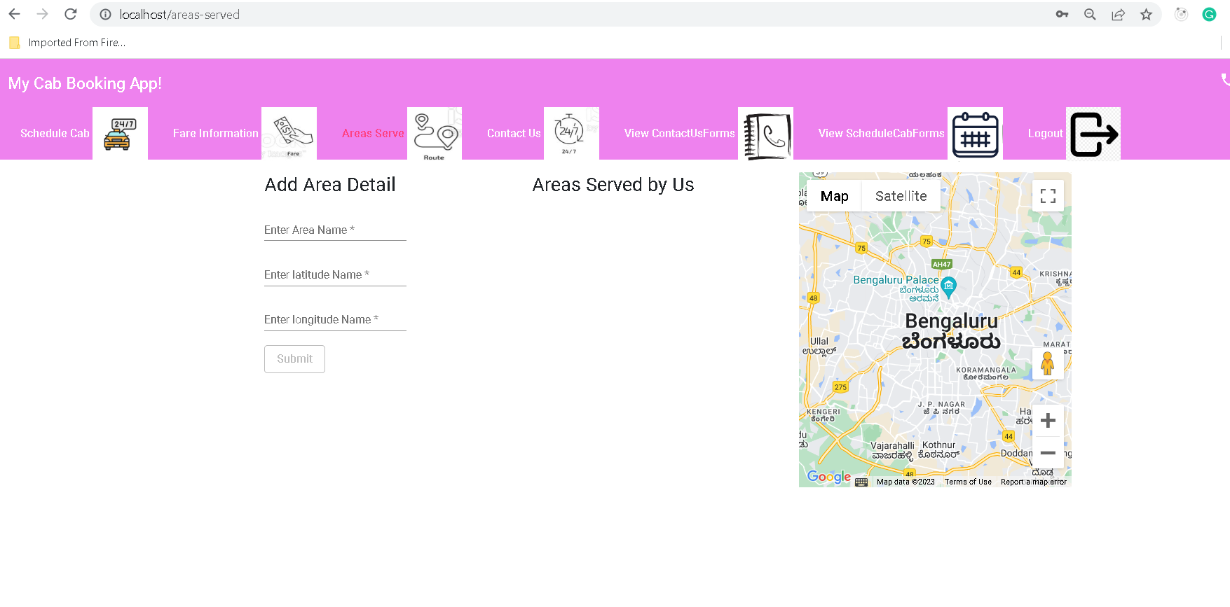
Admin can add area details using Latitude and longitude (In code area is given as Bangalore lat and long)

Slide 36
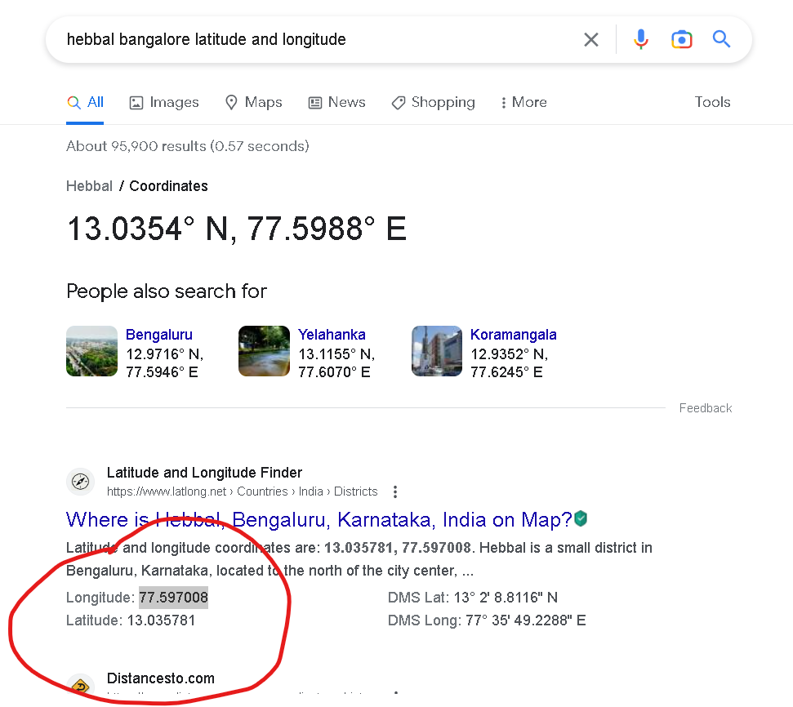
Add more area with help of google to find latitude and longitude

Slide 37
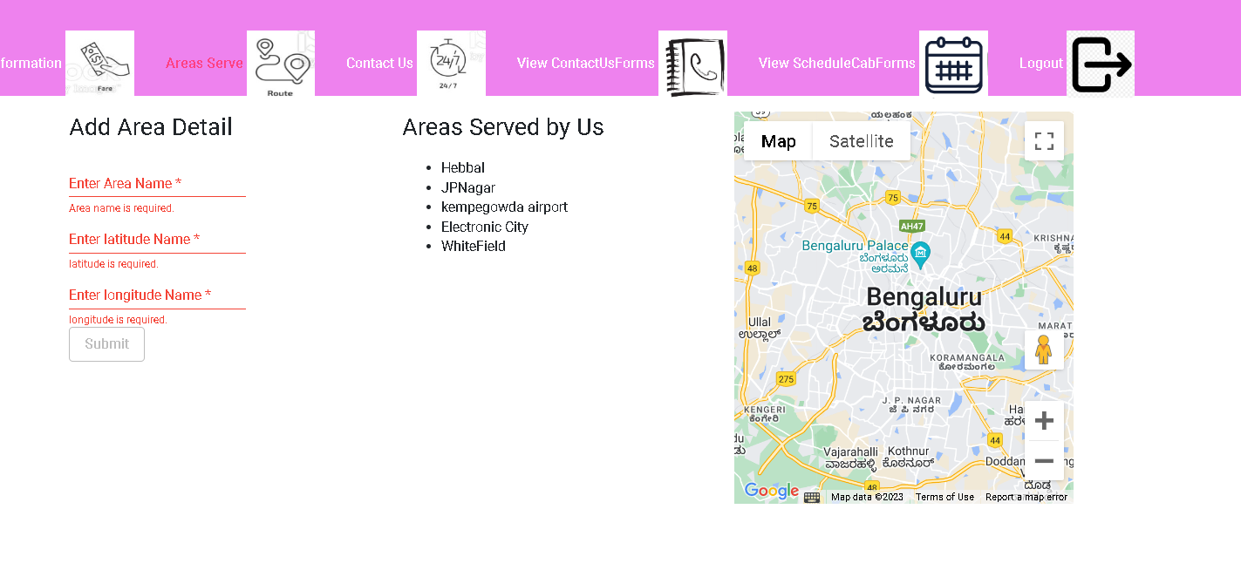
After admin added more area from Bangalore

Slide 38
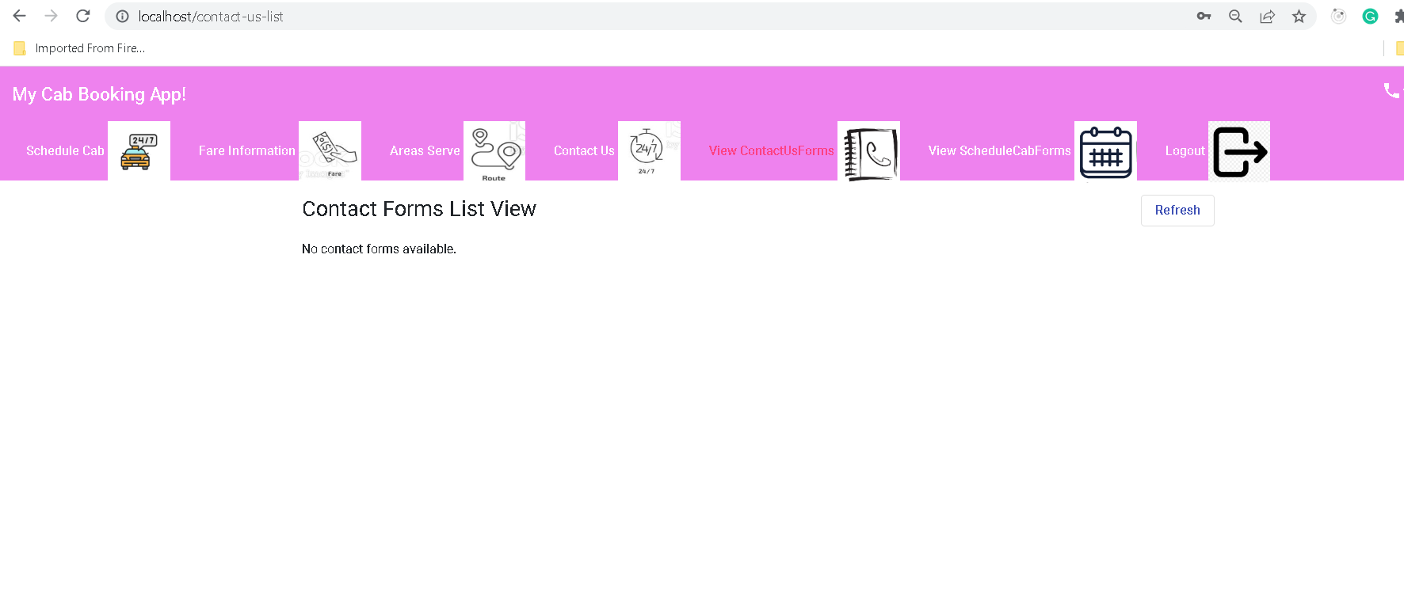
View Contact Forms

Slide 39
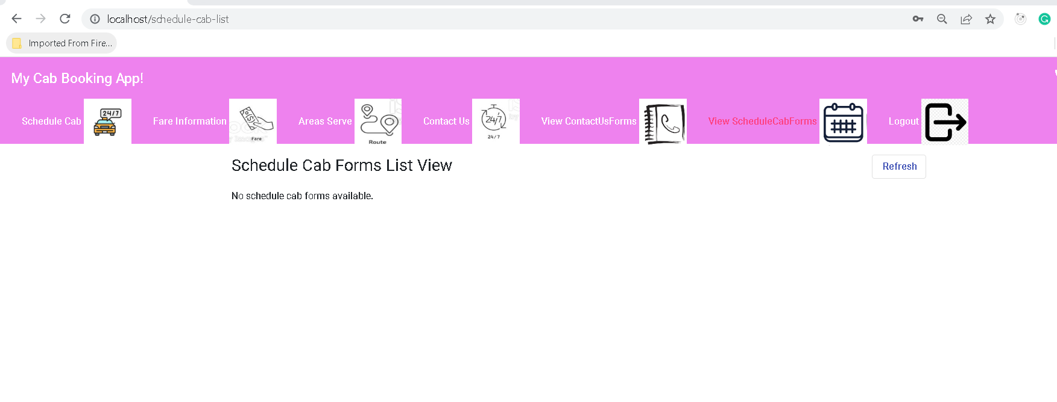
View Schedule cab forms details

Slide 40
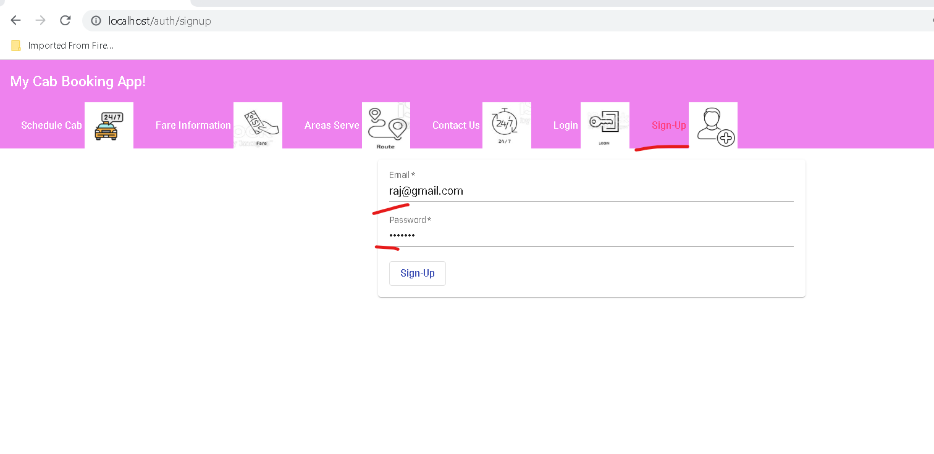
Sign Up for the Customer

Slide 41
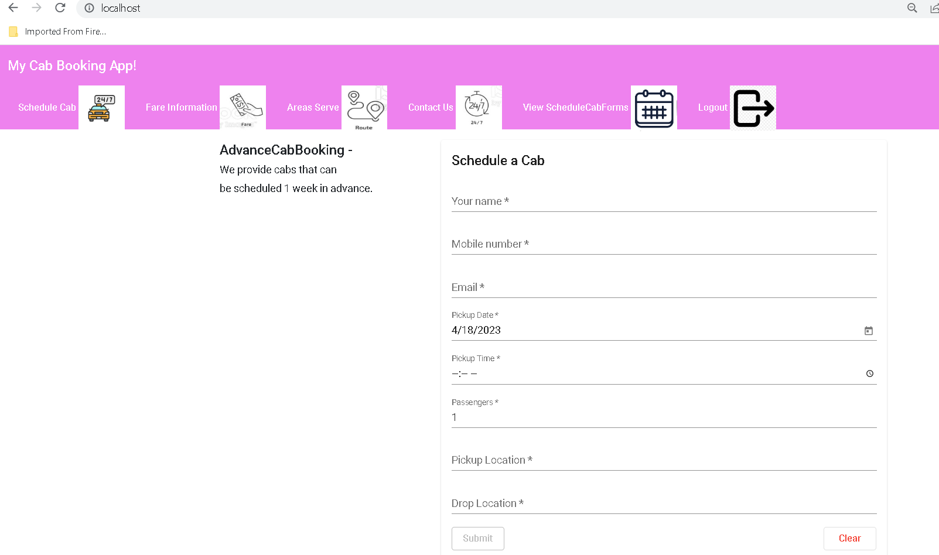
Sign in with customer credential

Slide 42
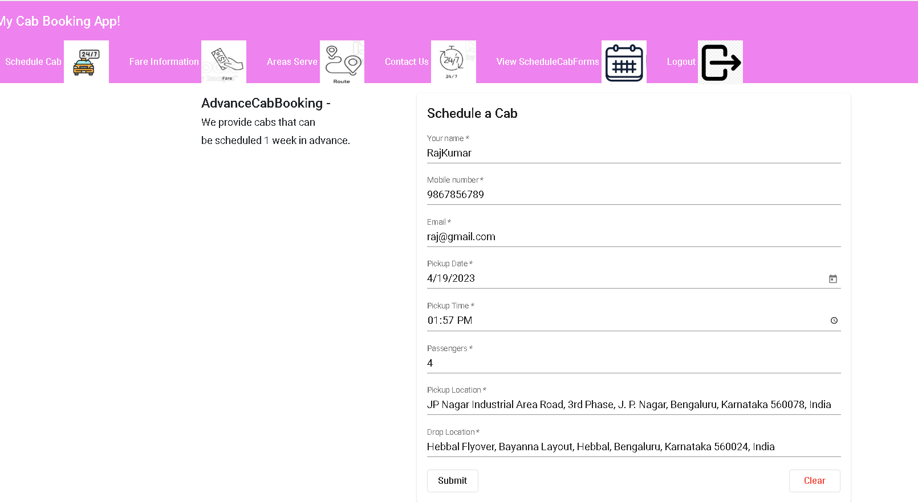
Customer can book the cab

Slide 43
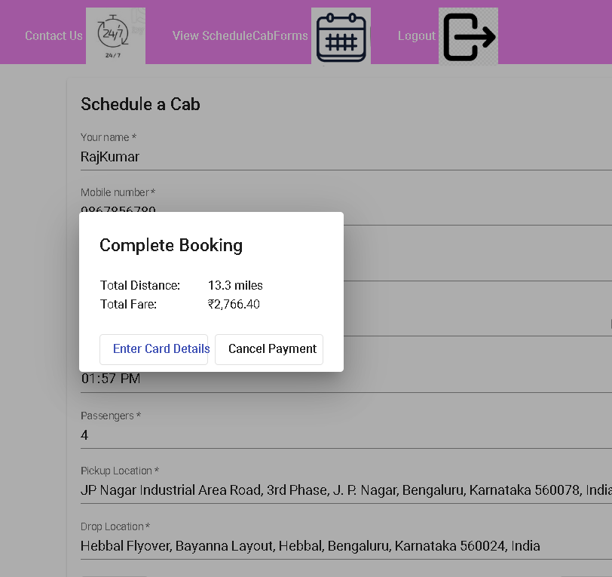
After submitted you will get pop up message

Slide 44
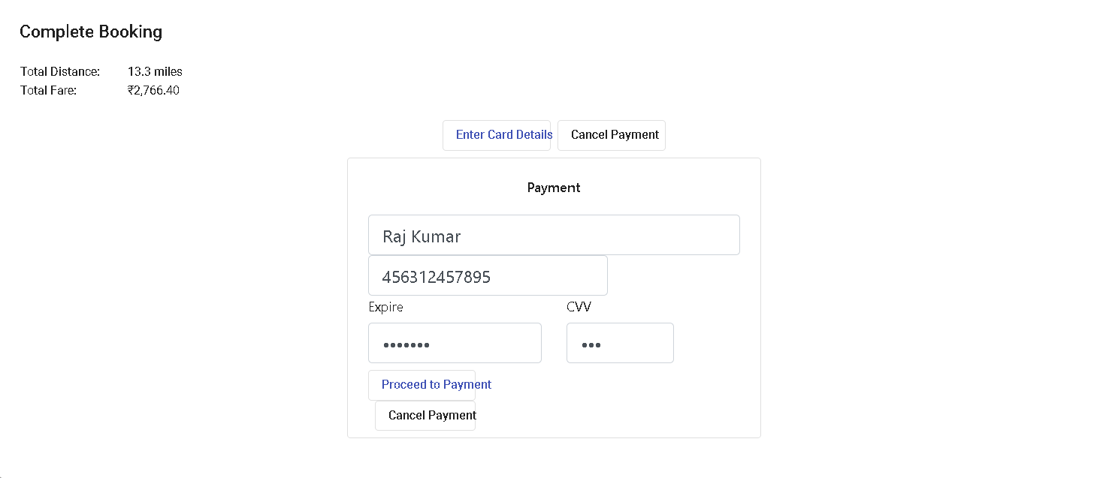
After fill the card details

Slide 45
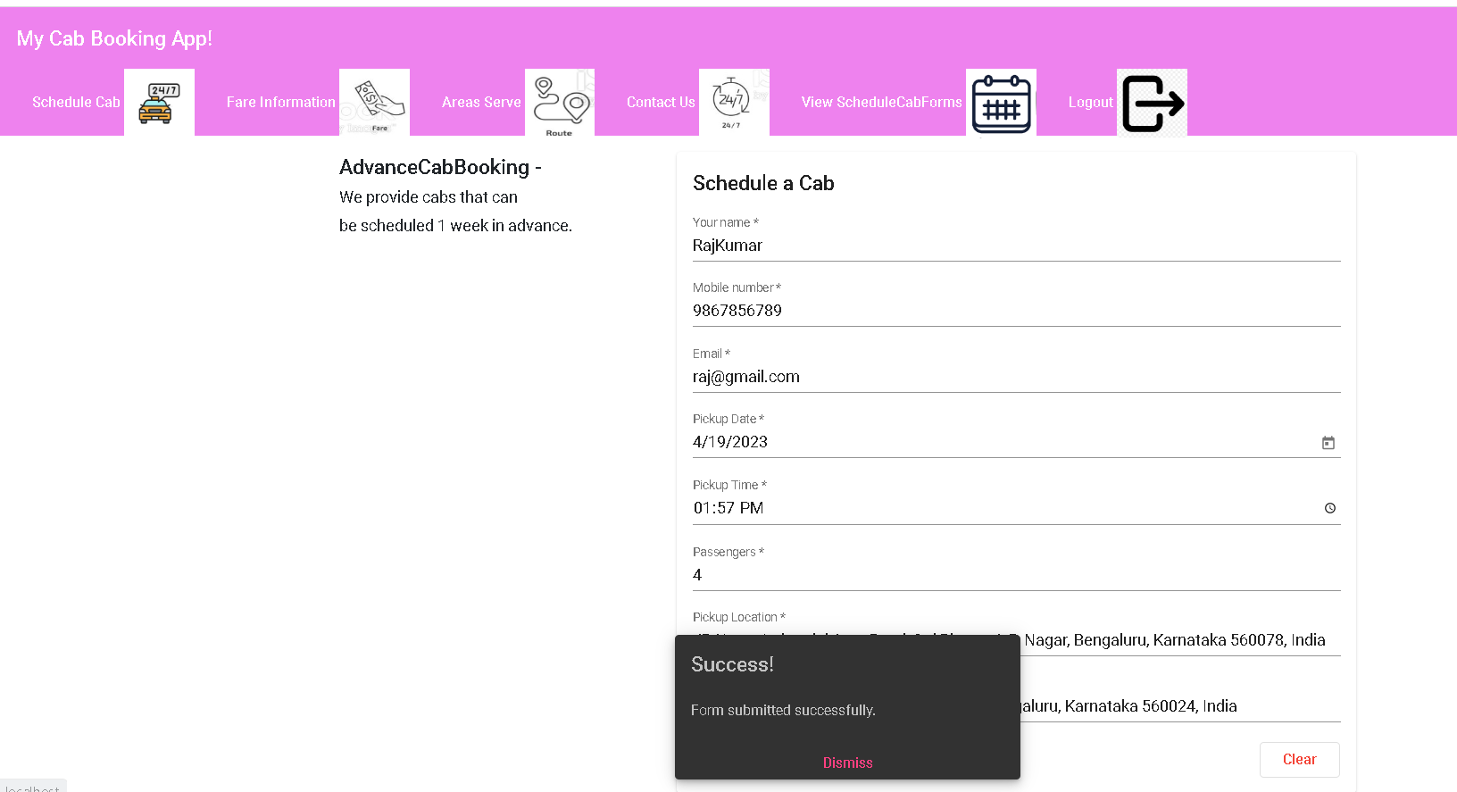
Customer can view payment confirmation

Slide 46
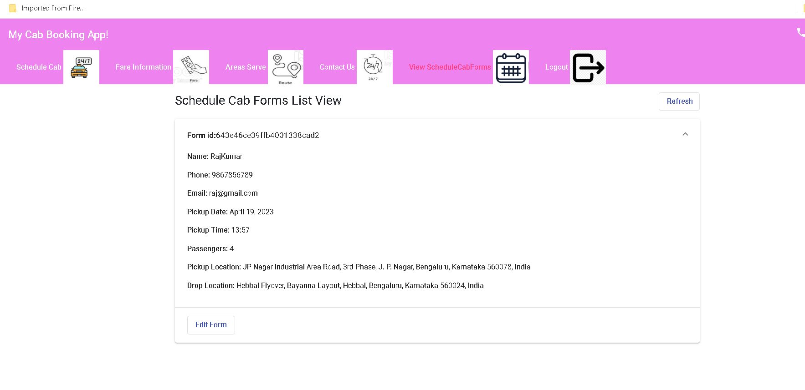
Customer can view its own cab booking details.

Slide 47
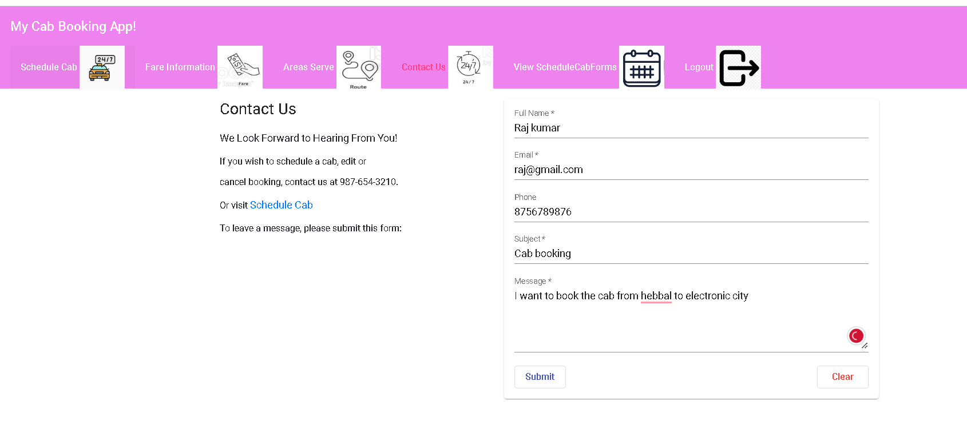
Customer can fill the contact form details

Slide 48
You can create another customer account and do the booking as well as contact details

Slide 49
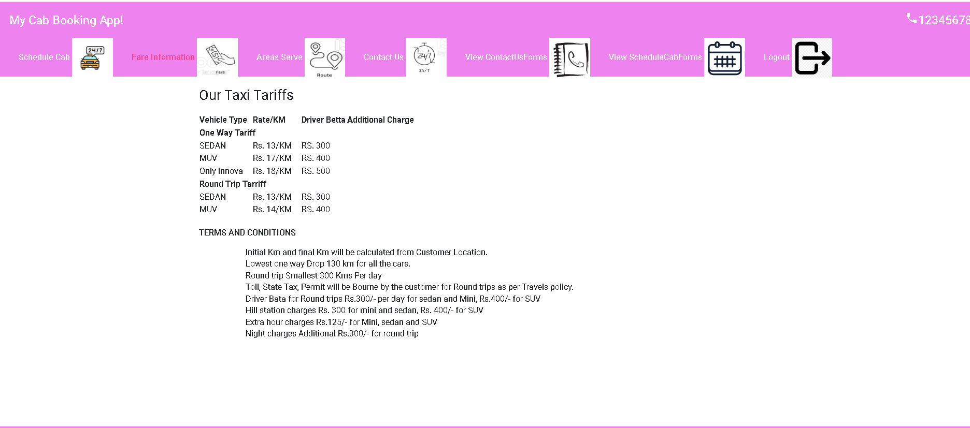
Now do the login using admin account

Slide 50
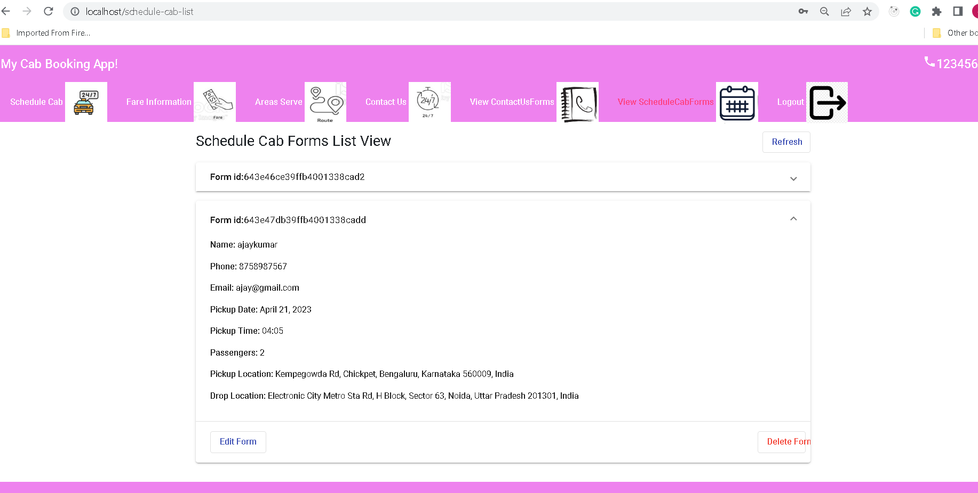
Admin can view all customer cab schedule details.

Slide 51
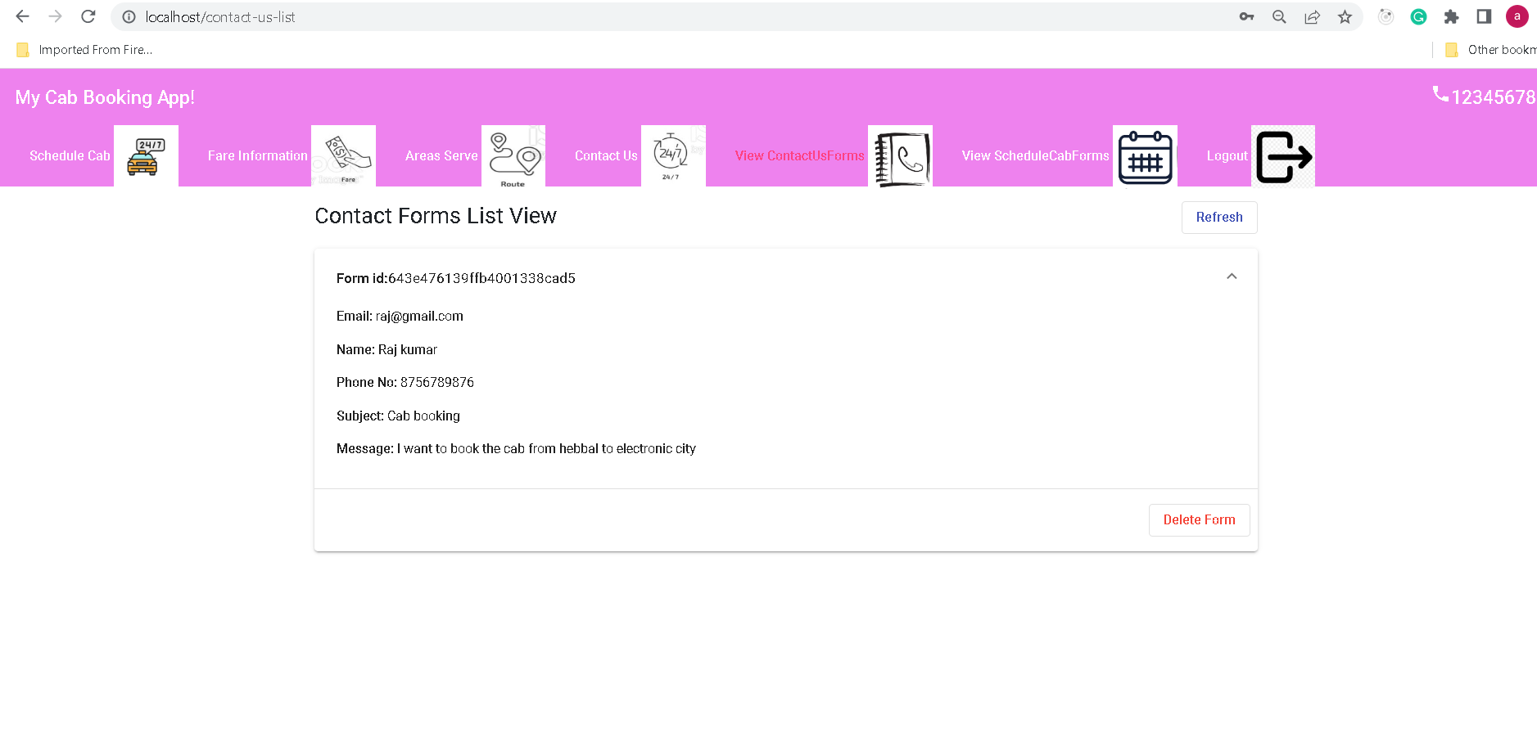
Admin can view contact form details send by customer

Slide 52
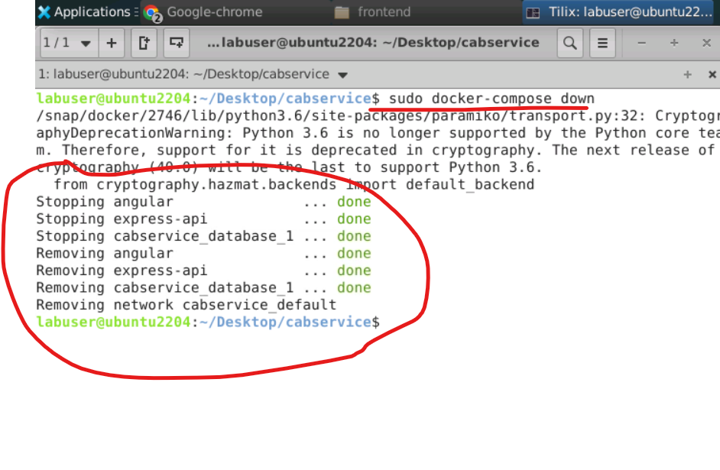
To stop all container using command as
sudo docker-compose down

